Slide 1


Smart Online 3D-Chess A Project Presented for Fulfillment For Diploma Project in Computer Science Submitted by 1.Ahmed Atef Abdel Jalil El-Habbak 2.Mohamed Saad Mohamed Metwaly Supervised by Dr. Ahmed Hamzah Cairo, Egypt July 2022`
Cairo University
Faculty of Graduate Studies for Statistical Research
Department of Information Systems & Technology

Slide 2
Presentation Outline
Introduction
System Analysis
System Design
Implementation Details
Conclusion and Future Work

Slide 3
1-Introduction

Slide 4
1-1 Problem Statement
Chess is the most popular board game player by people from all walks of life.
Chess originated in India in the 7th century.
Chess pieces and rules developed in 19th century.
Chess can be played in computer through internet.
Within this project we design and implement a version of chess game with G.U.I
The developed game can be played through L.A.N
1-2 Scope
Project focuses on G.U.I implementation
Project follows all basic rules of the chess such as check , checkmate and capturing
Project enable players to play game through L.A.N
Project don’t enable a human player to play chess against computer
1-3 purpose
Deep desire to understand the game in better way
Developing more efficient algorithms for implementing basic rules
Implementing the courses undertaking during our study
Challenging knowledge we have gained
An opportunity to strength this knowledge

Slide 5
2-System Analysis

Slide 6
2-1 System Architecture
Peer-to-peer system architecture
both of computers linked together with equal permissions and responsibilities for processing data
Any device in peer-to-peer architecture are designated to serve or receive data
Peer-to-peer
peer 1
Client/host player
peer 1
Client/host player
2-2 System Requirements
2-2-1 Functional Requirement
System shall allow local player to play local game
System shall allow local player to play local game
System shall allow local player to move chess piece
System shall allow local player to check whether move is valid or not
System shall allow local player to capture piece
system shall allow local player to perform castling
System shall allow local user to perform promotion
System shall allow local player to perform EnPassant
System shall allow local player to perform checkmate
System shall allow local player to perform exit from game
System shall allow local player to rematch chess game

Slide 7
2-2-2 Non-functional requirements
Non-functional requirement describe services provide by system under which the system operational constraints thereby we can summarize non-functional requirements at the following points:
Base and pieces must not be overly large.
User interface must be easy to understand and use by players.
peace movement system must move pieces in properly right way.
The game will have no more than a 3 second lag between user input and response.
Application will not be being crashed while it’s used.
Application can be installed on any windows platform.

Slide 8
Use-Case Diagram

Slide 9
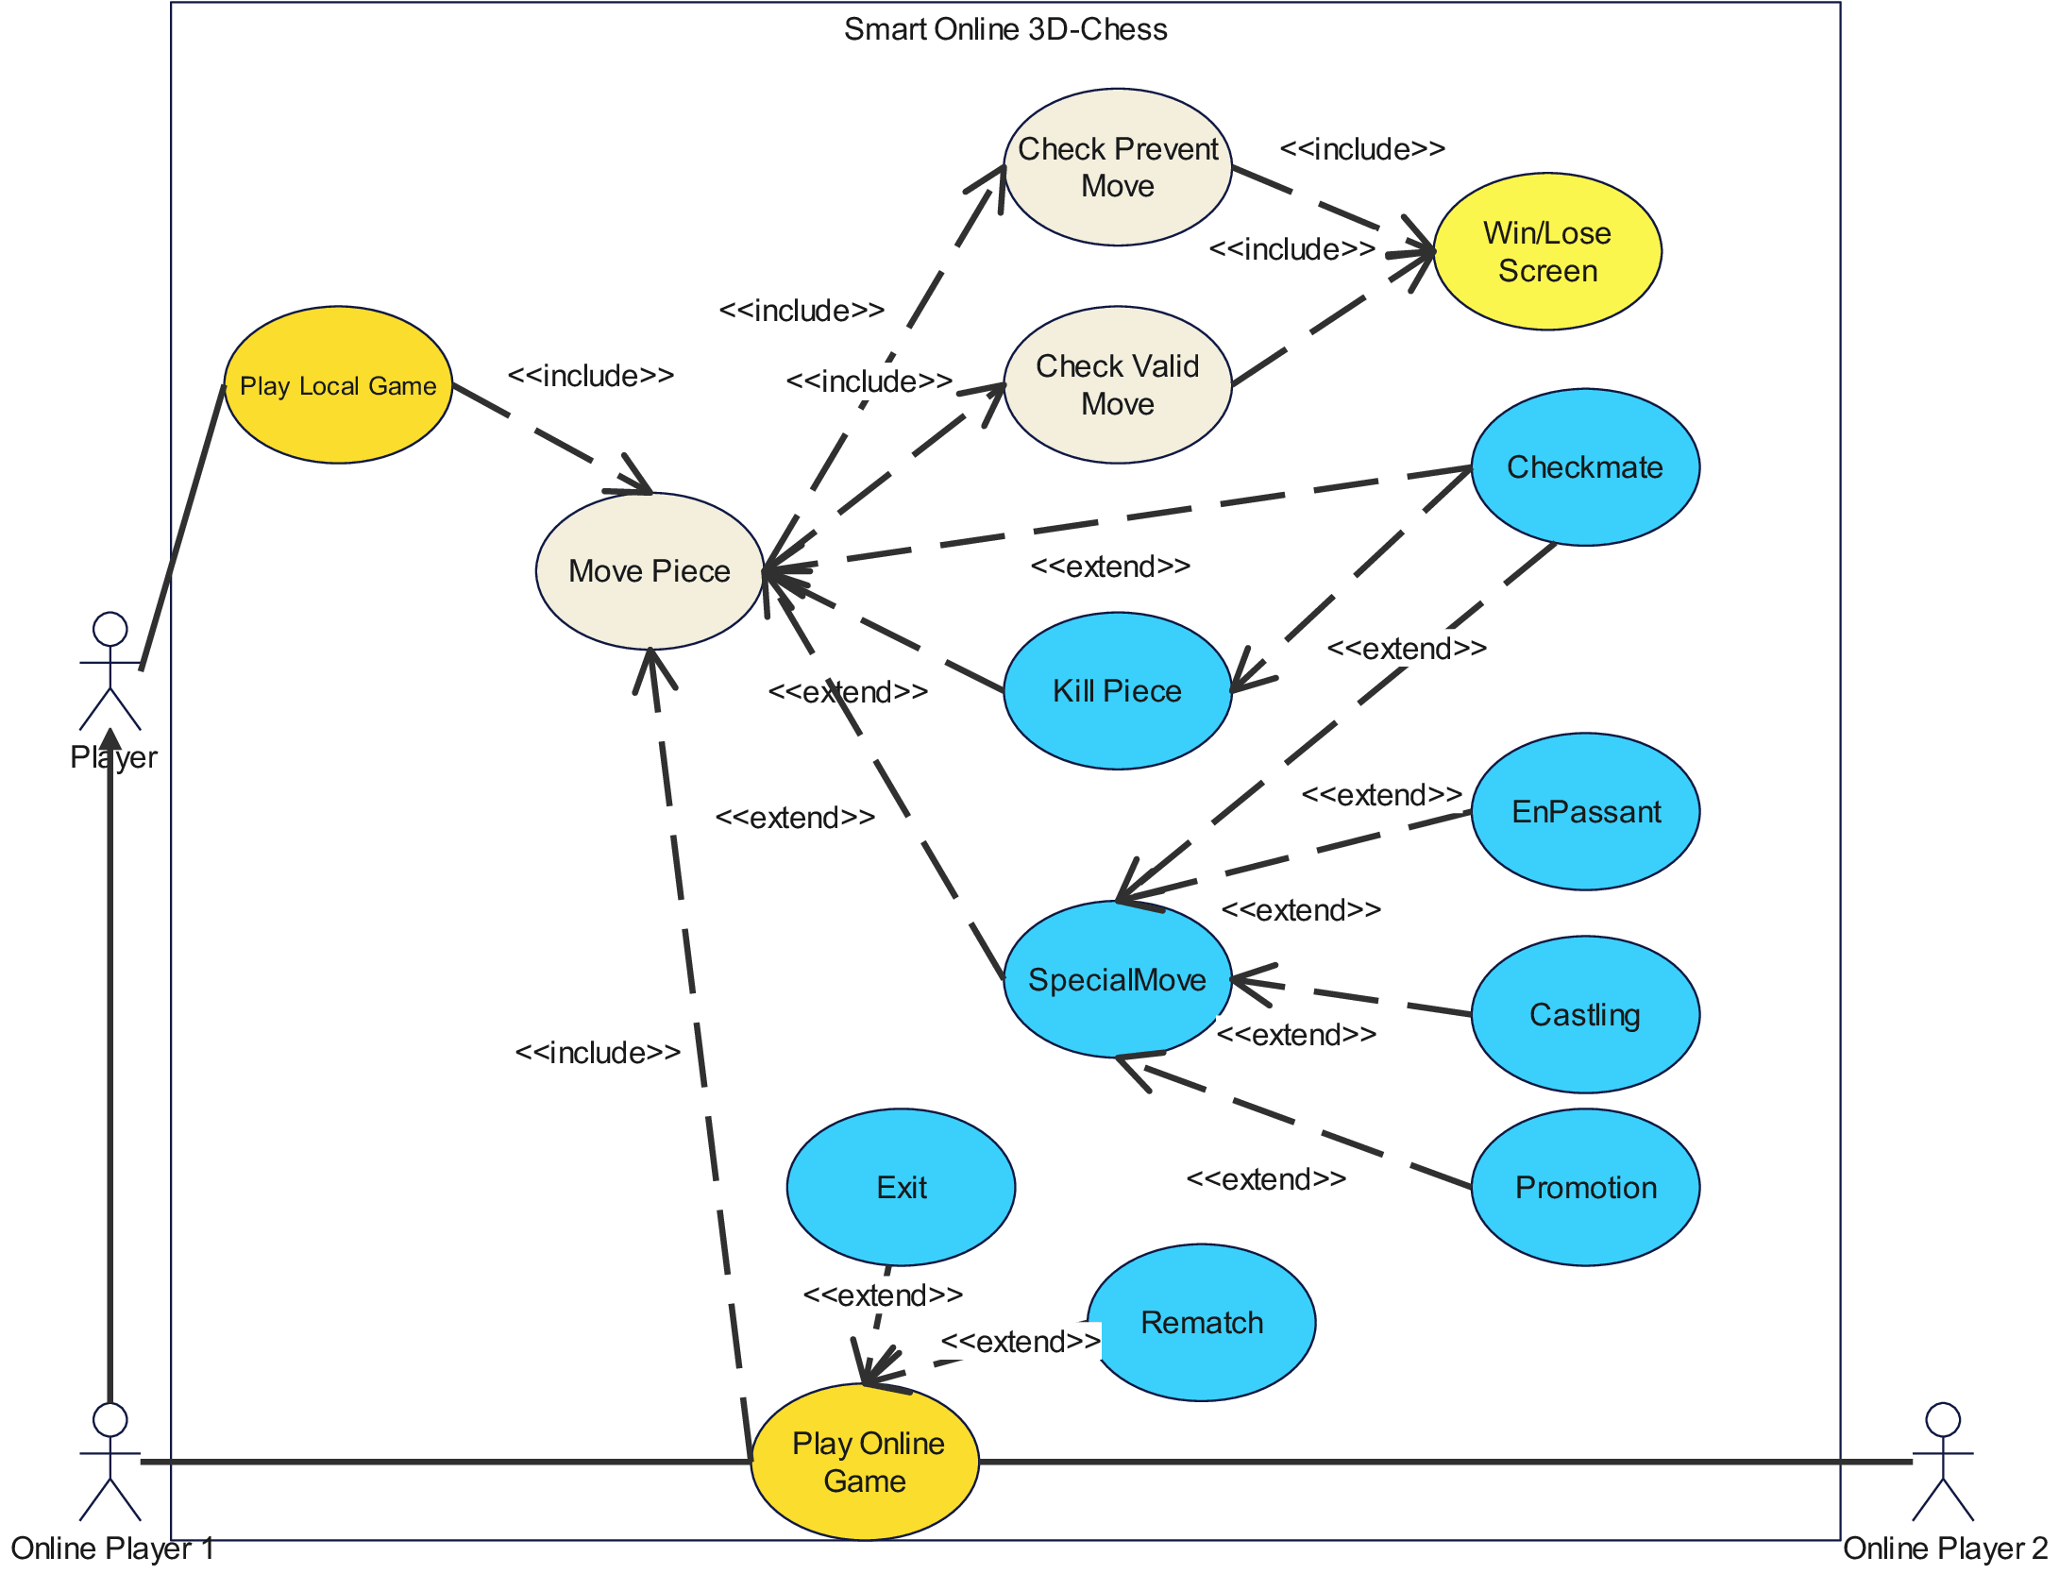
2-2-3 Use-Case Diagram

Slide 10
Activity Diagram

Slide 11
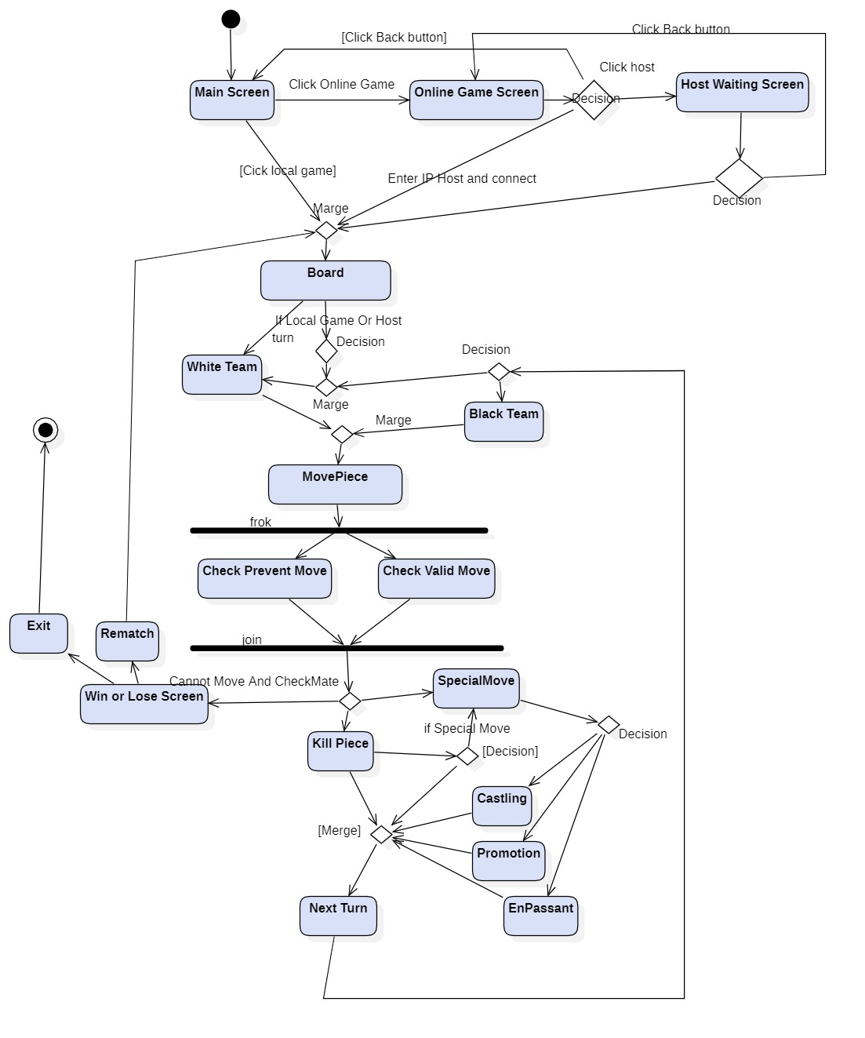
2-2-4 Activity Diagram

Slide 12
Sequence Diagram

Slide 13
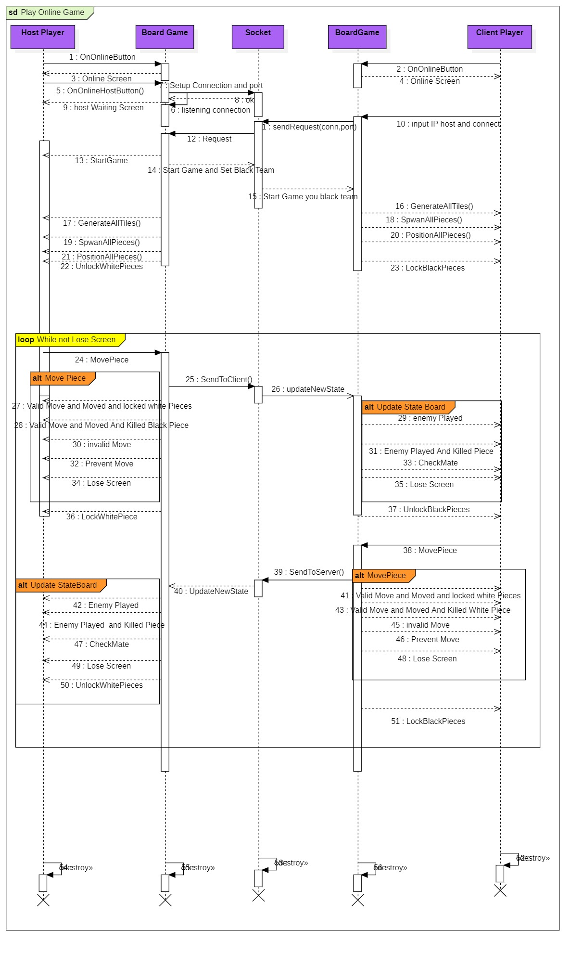
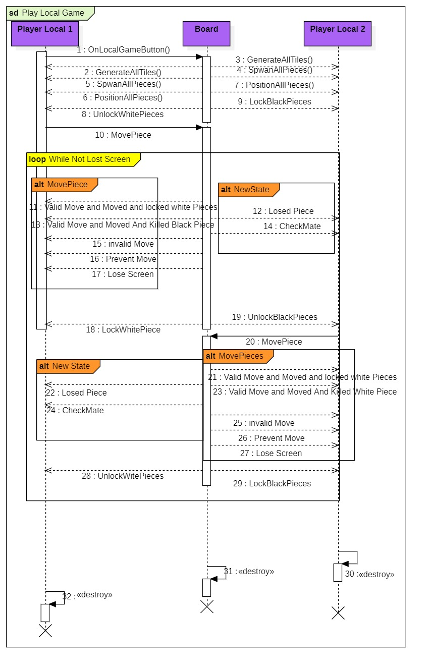
2-2-5 online player sequence Diagram
2-2-5 local player sequence Diagram

Slide 14
3-System Design

Slide 15
Component Diagram

Slide 16
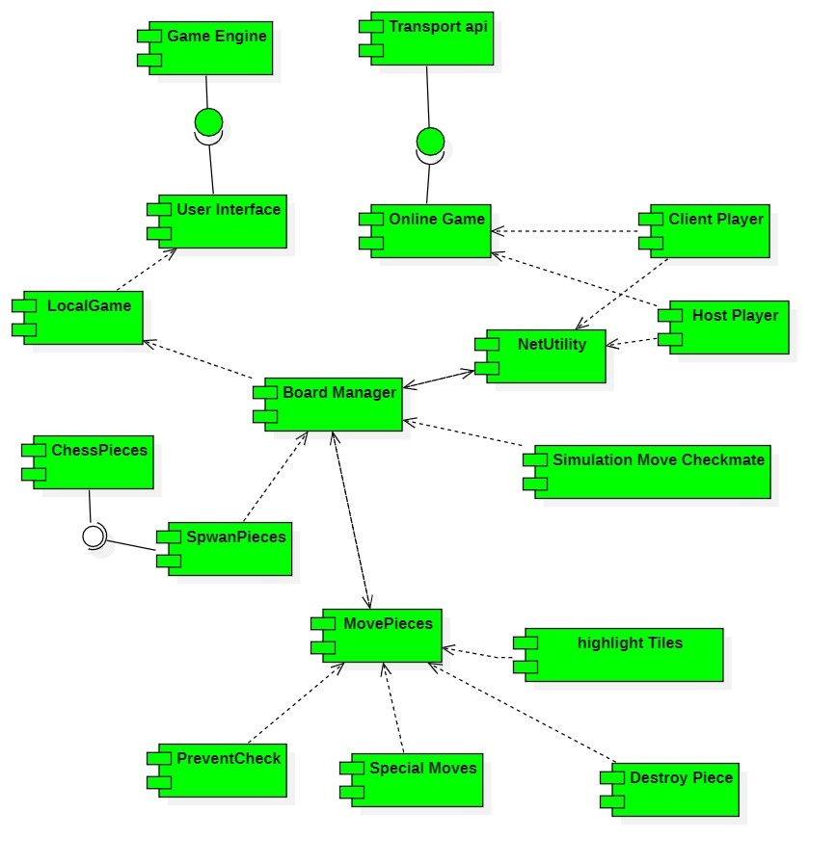
3-1 component Diagram

Slide 17
Class Diagram

Slide 18
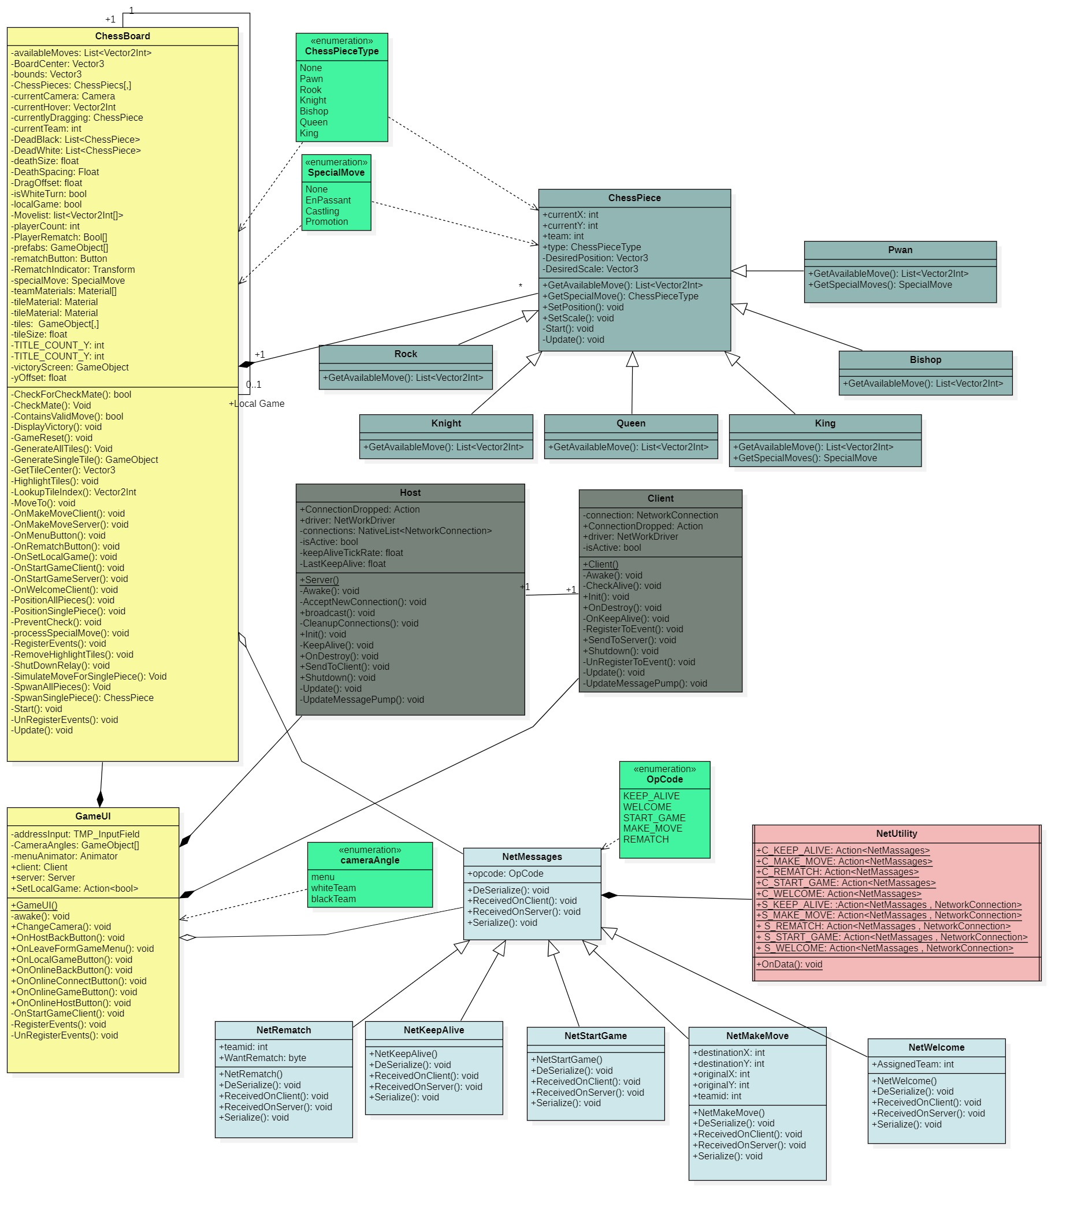
3-2 Class Diagram

Slide 19
4-Implementation Details

Slide 20
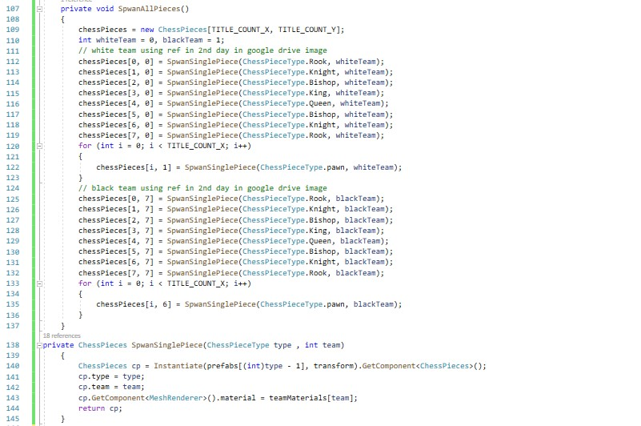
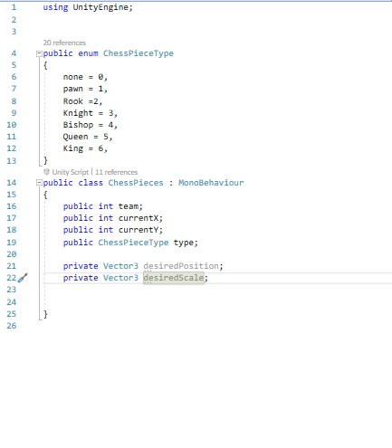
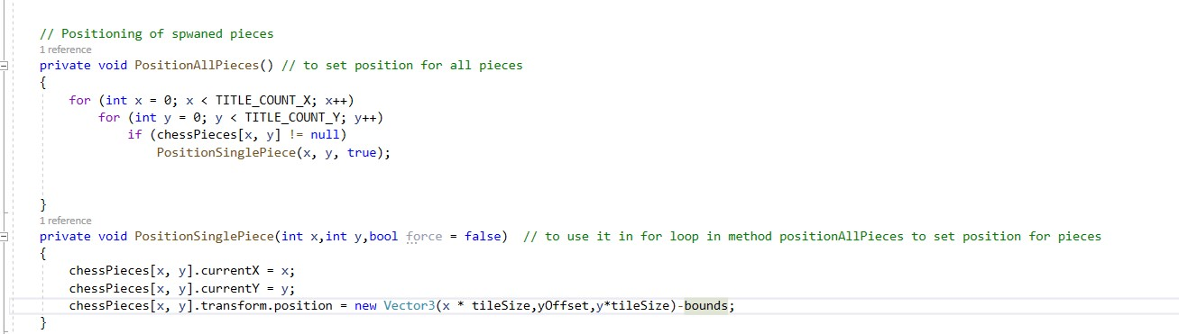
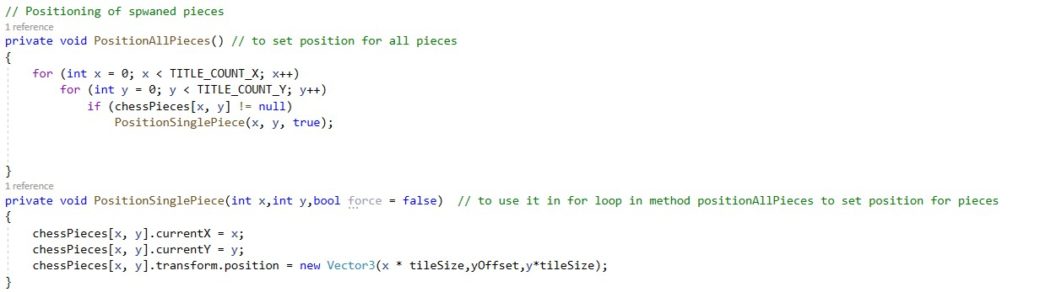
4-1 some phases of code implementation

Slide 21
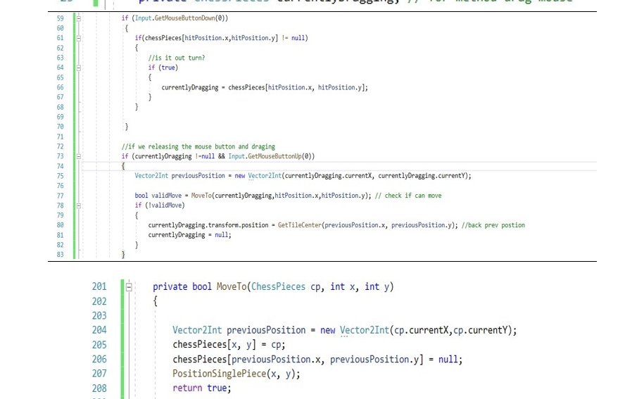
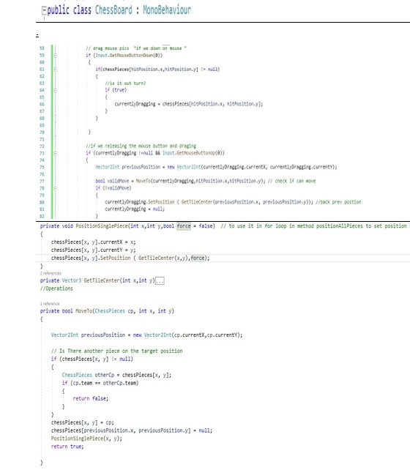
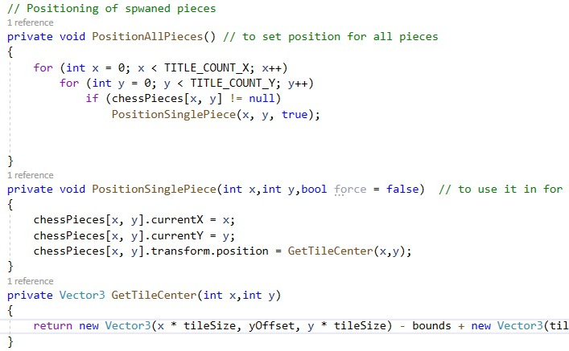
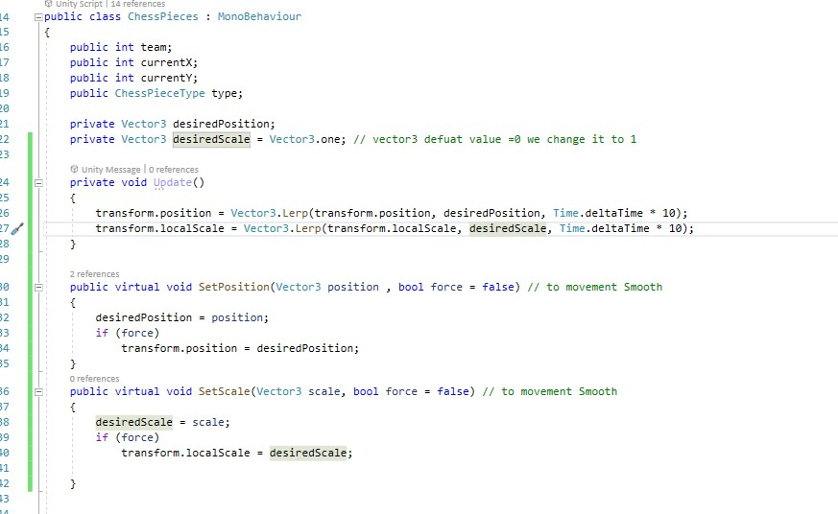
4-1 some phases of code implementation

Slide 22
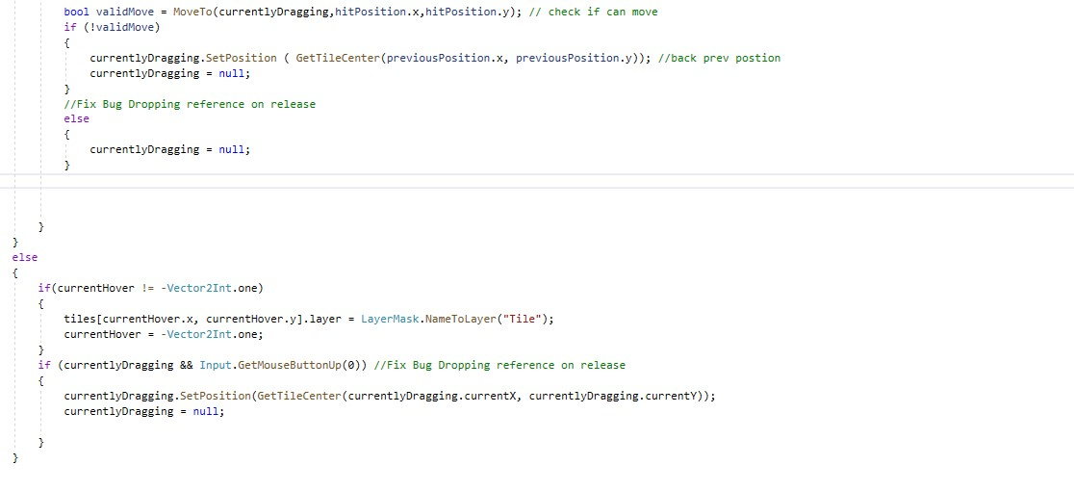
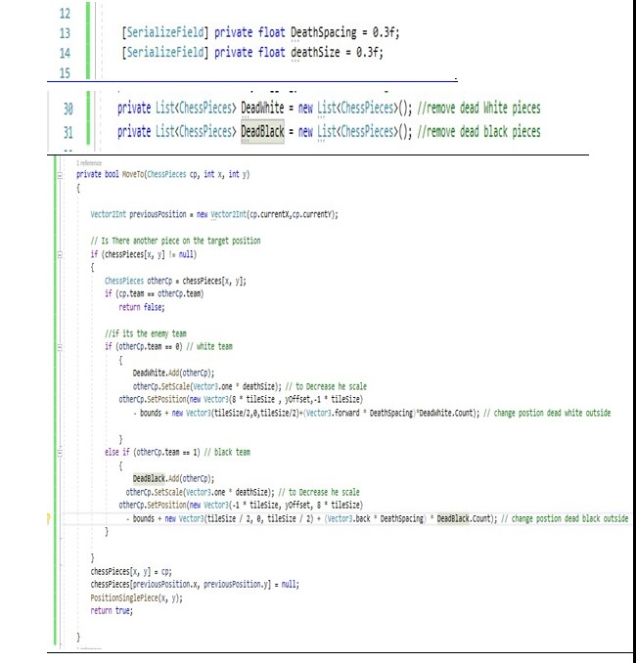
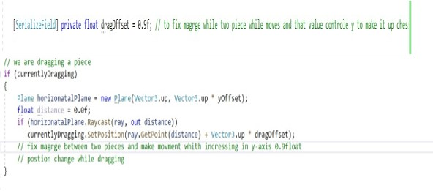
4-1 some phases of code implementation

Slide 23
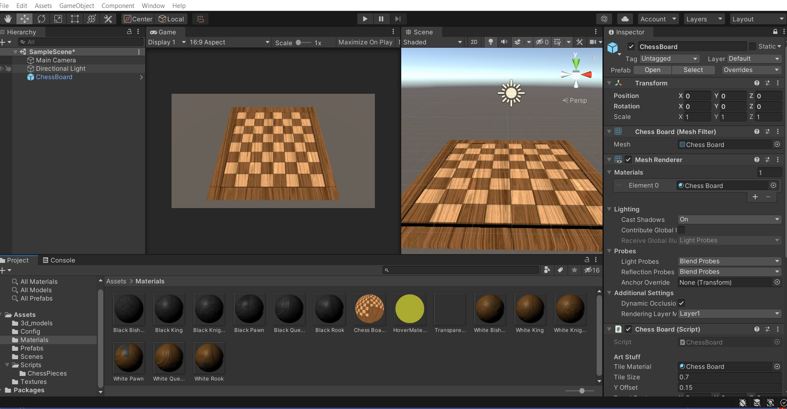
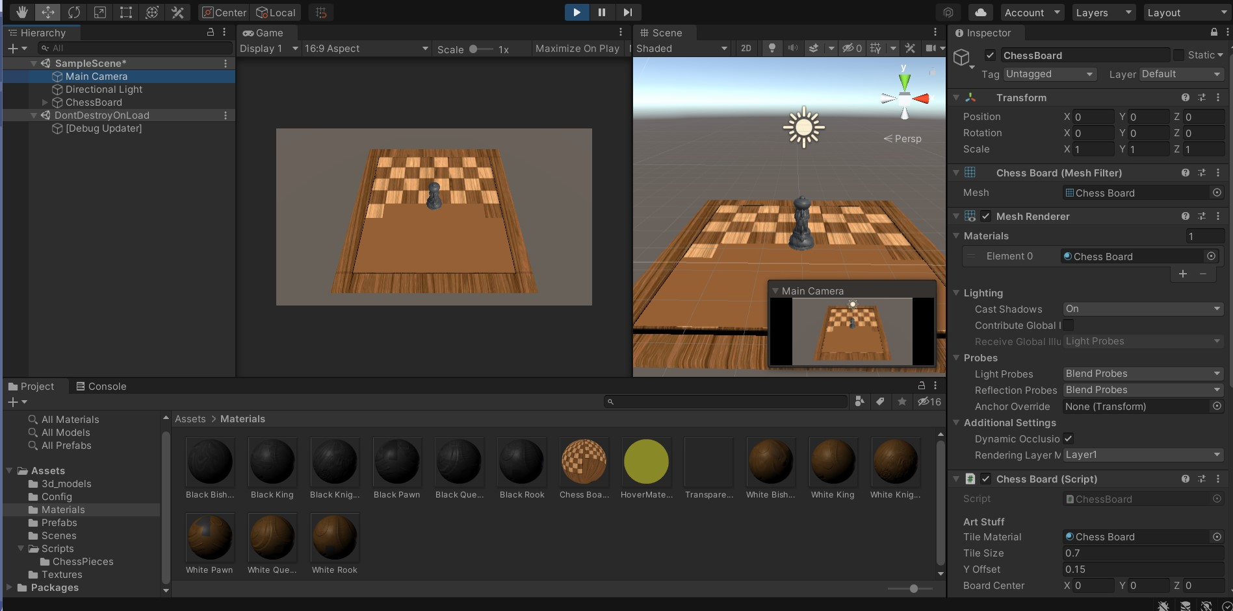
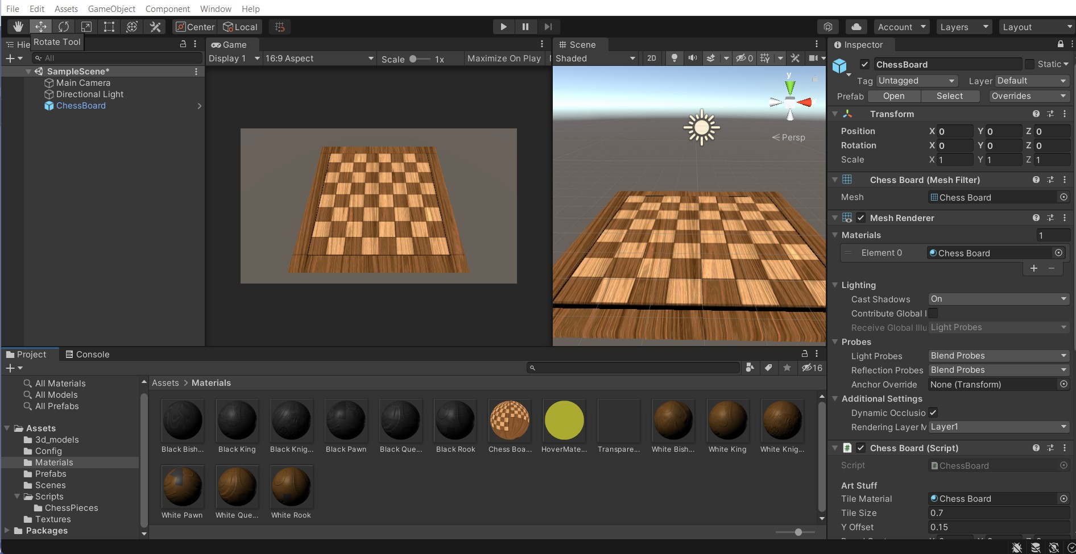
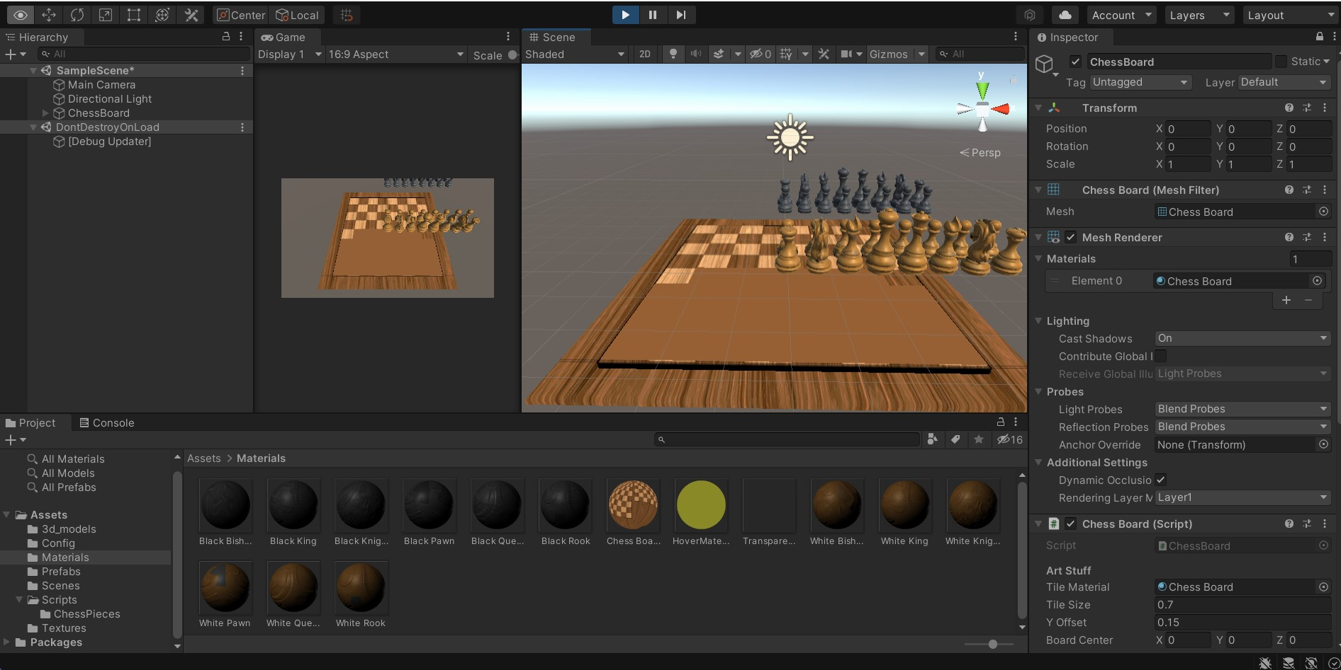
4-2 Functionality test

Slide 24
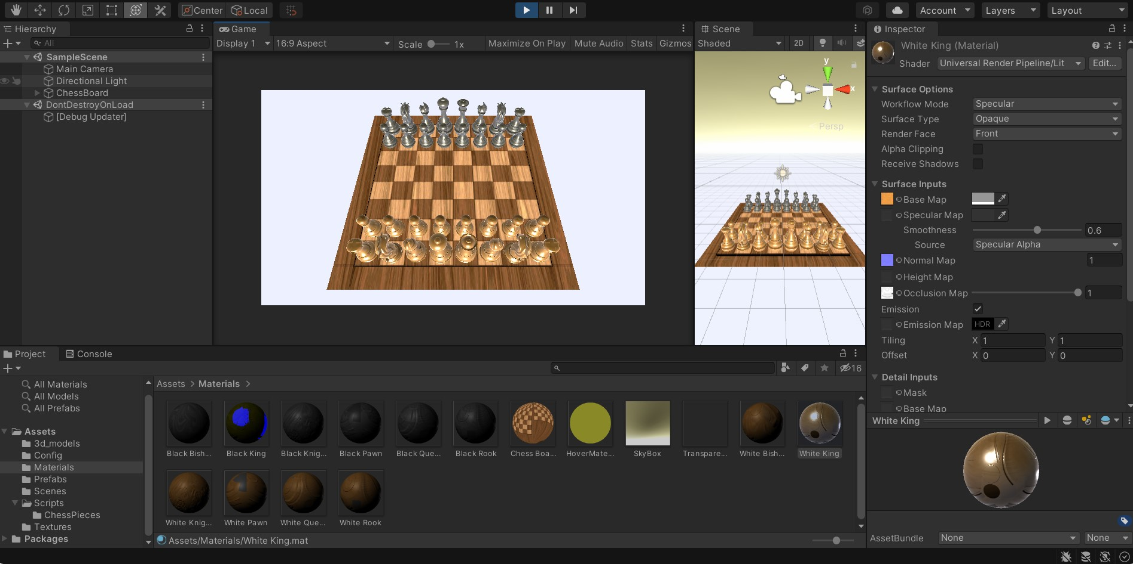
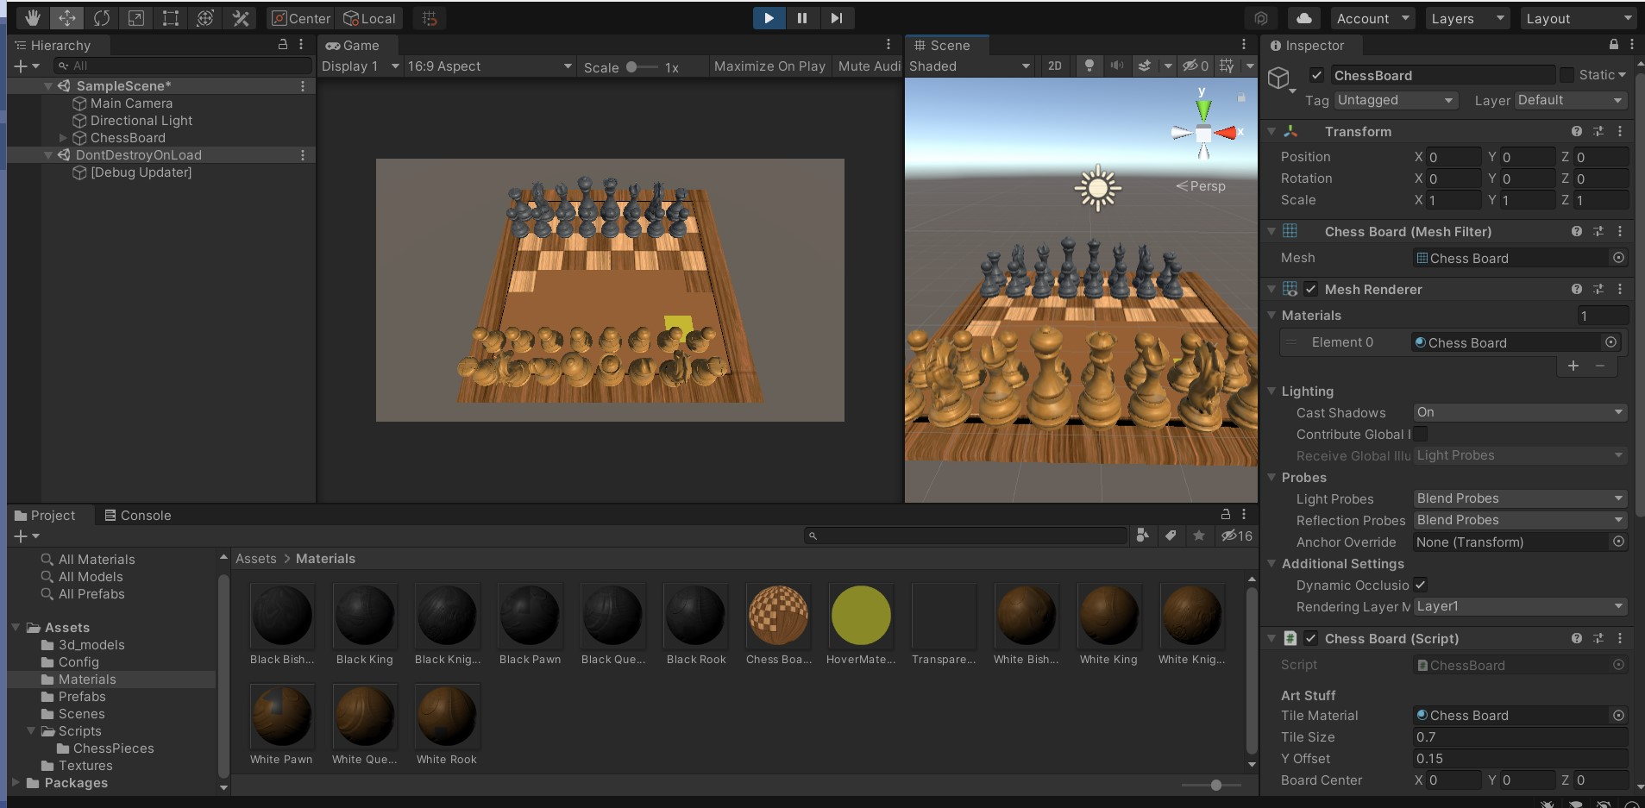
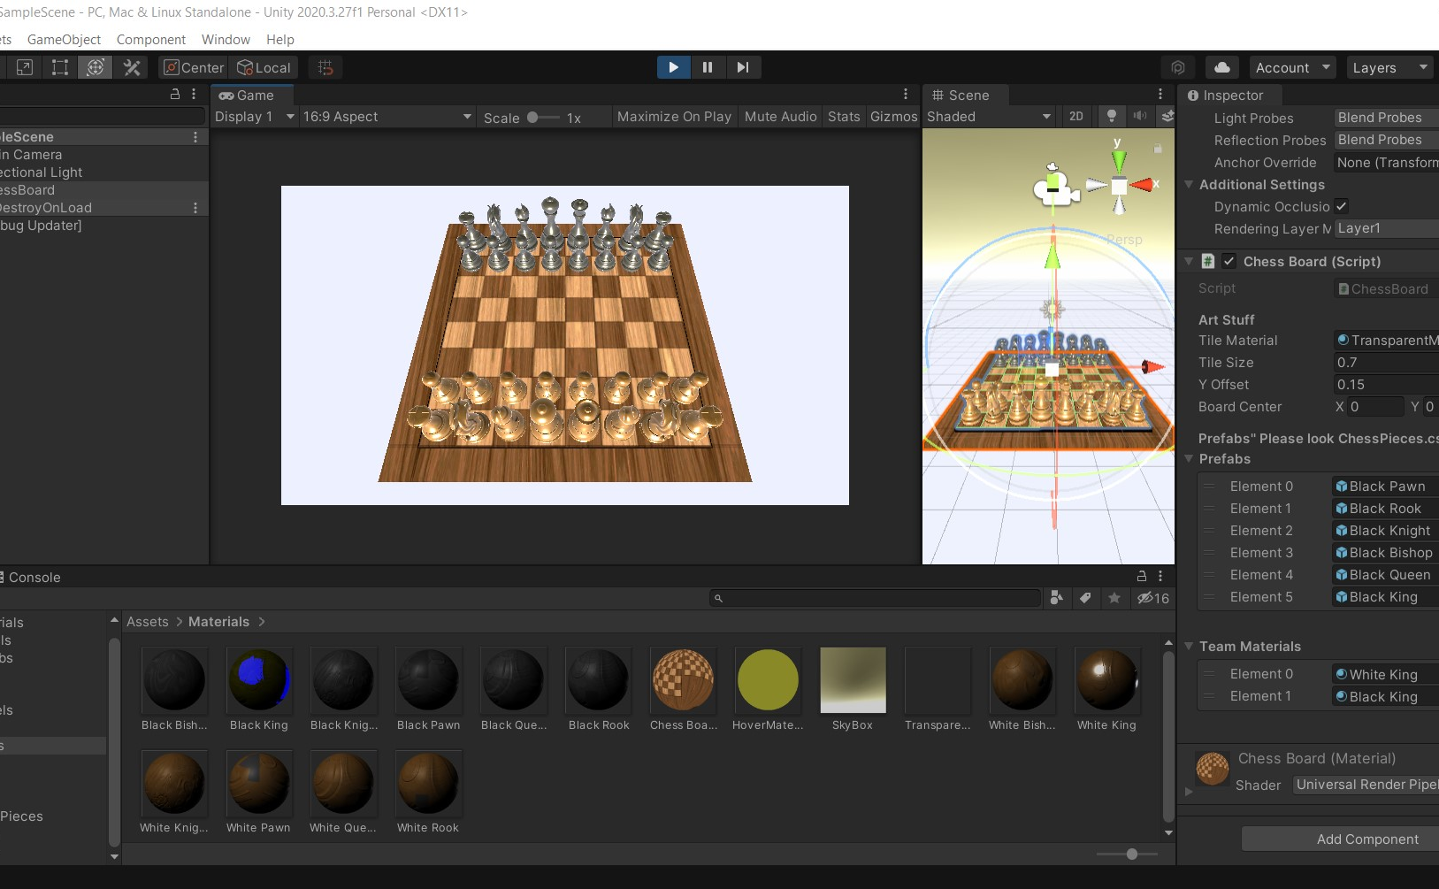
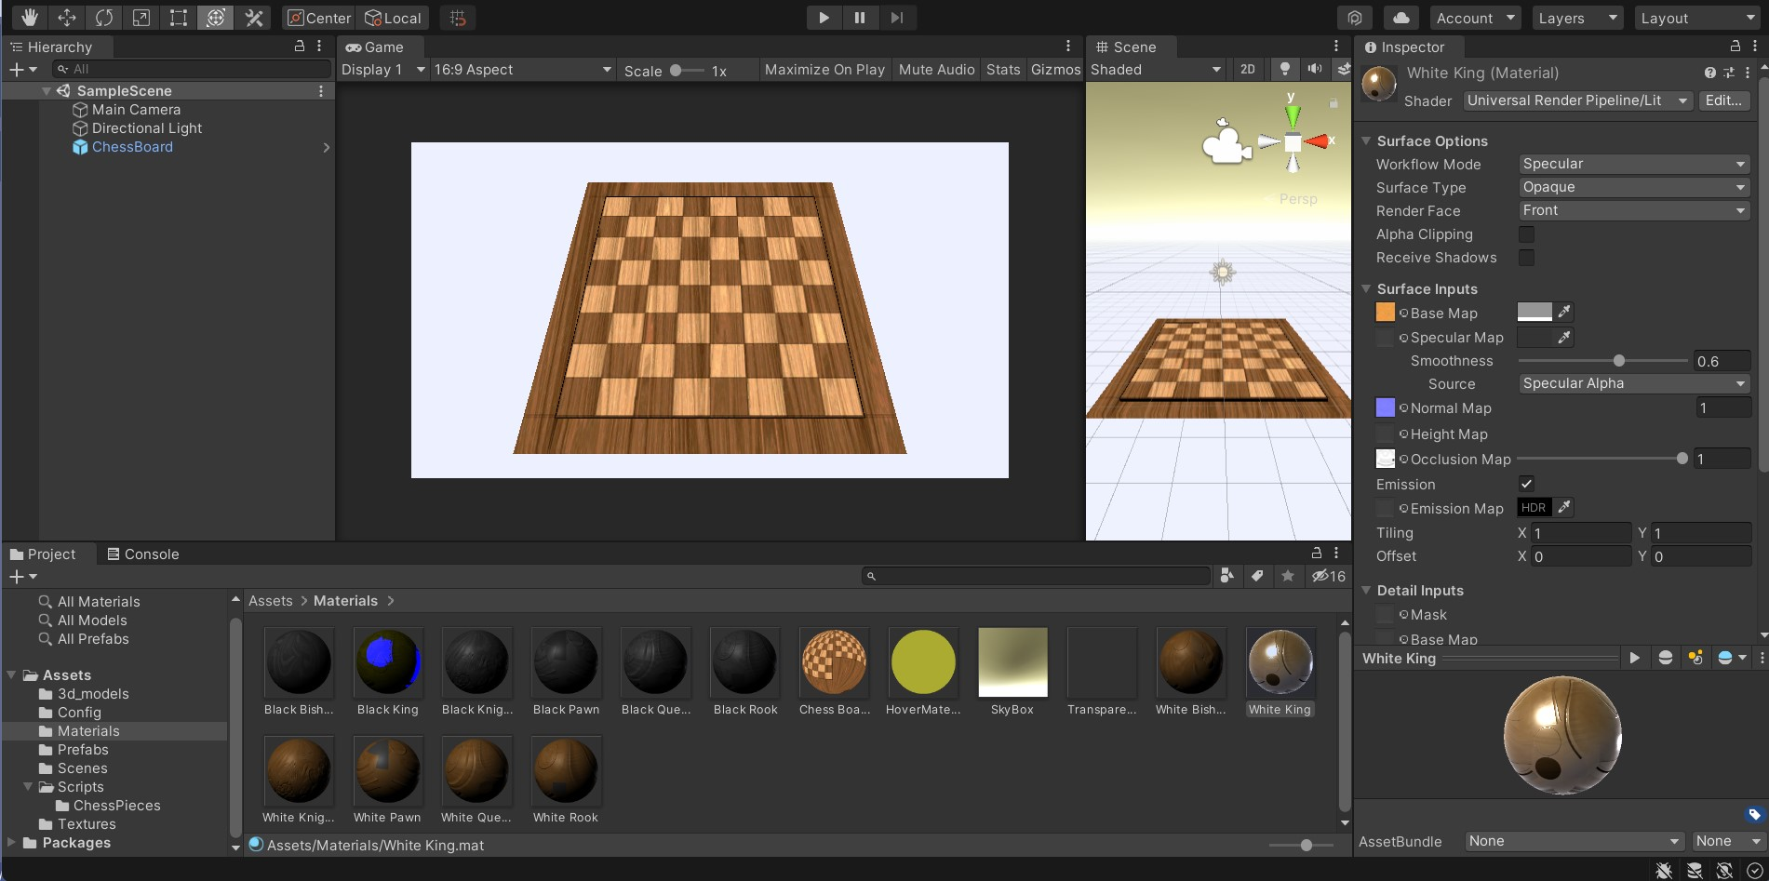
4-2 Functionality Test (continued)

Slide 25
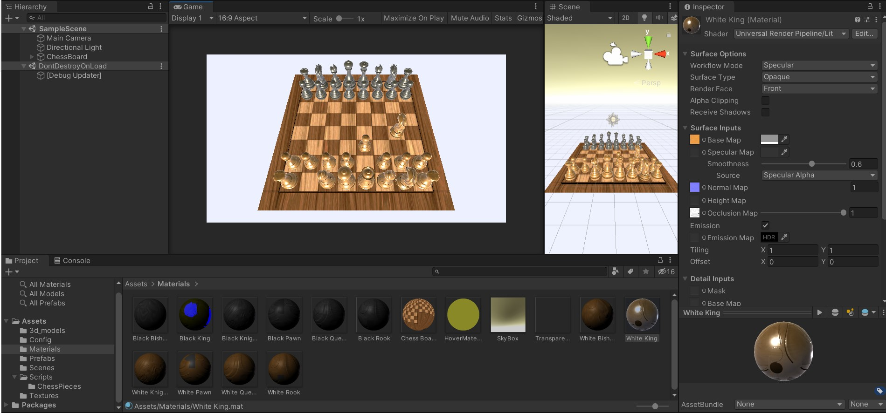
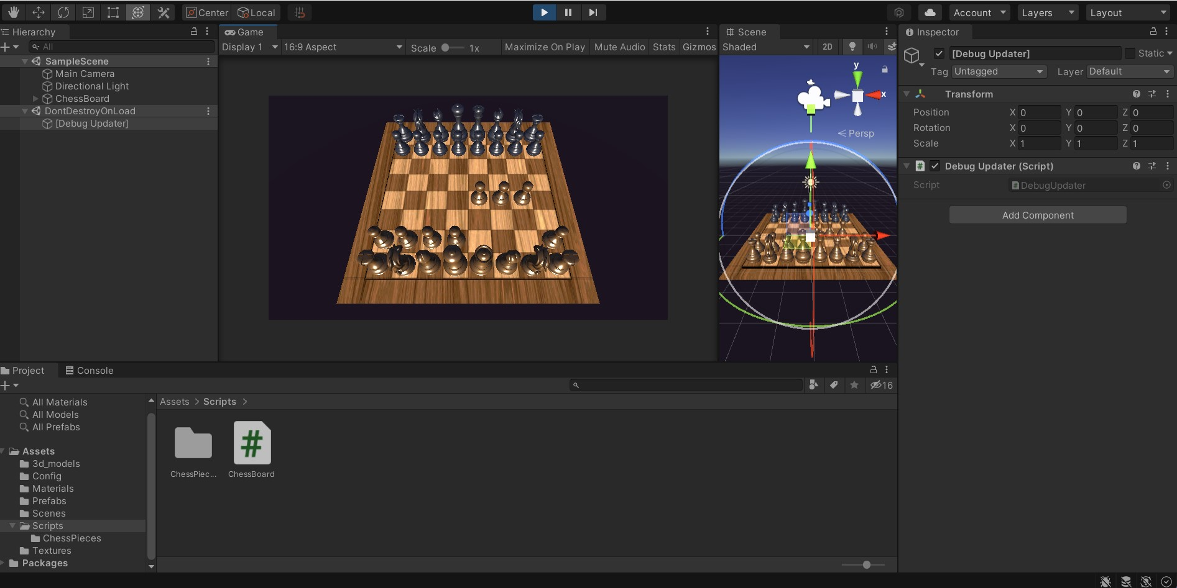

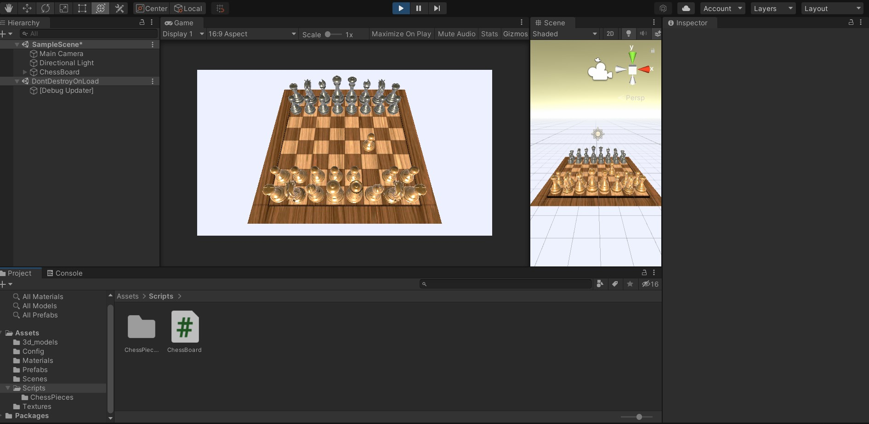
4-2 Functionality Test (continued)

Slide 26
5-Conclusion & Future work

Slide 27
5-1 Conclusion
Now we reached to the final section of our project report, so we can summarize our project in the following main points :
We successfully develop a chess game by using OOP principals and G.U.I
Allow players to play chess game simultaneously, in other words playing chess game interactively at the same time .
Allow players to play chess game over a network through LAN
5-2 Future Work
As for the available time and due to the Covid-19 pandemic. we decided to accomplish this project as possible as we can do. hopefully in the future we can develop an AI such as minimax with alpha beta pruning algorithm in which player of chess game can play chess with his device whether this device is PC or smart phone.

Slide 28
THE END

